Slide 1
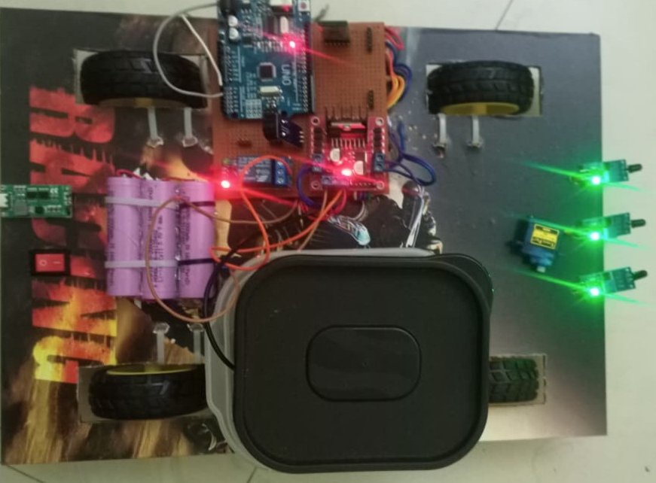
BLUETOOTH & AUTOMATIC CONTROLLED FIRE FIGHTER
AN IOT Based solution for emergency response

Slide 2

hmfa memorial institute of engineering and technology handia prayagraj .
Affiliated by
Dr. A P J Abdul Kalam Technical University Lucknow
Session 2025-2026
Department of Electronics & comm. Engineering

Slide 3
submitted by
Name : Ram Kishun Name : Rupesh Kumar
Roll no : 2304110319025 Roll no : 2304110319026
Name : Shyam Kumar Name : Sumit Gupta
Roll no : 2304110319036 Roll no : 2304110319038

Slide 4
Introduction
Fire accidents are one of the most dangerous and unpredictable disaster that cause hug loss of life and property every year . In many case ,fire fighters risk their lives to extinguish fire in dangerous areas like chemical plants narrow lanes or buildings filled with smoke .
To reduce human risk and increase efficiency, we have designed a BLUETOOTH AND AUTOMATIC CONTROLLED FIRE FIGHTER . This robot is a compact low cost solution that can detect fire and extinguish it without human intervention.

Slide 5
Objectives
The main objectives of desining the Bluetooth and automatic controlled fire fighter
To detect fire automatically : To use flame sensors for detecting the presence and direction of fire in real time without any human help .
To provide dual control : To operate the robot in both manual mode using a Bluetooth mobile app and automatic mode for autonomous fire extinguishing.
To ensure human safety : To reduce the risk to human fire fighters by sending the robot into dangerous or narrow areas where human cannot reach easly
To develop a low cost solution : To build an affordable and effective fire fighting system using Arduino and basic electronic components for small –scale fire emergencies.

Slide 6
Block diagram
Bluetooth
HC- 05
BATTERY
FLAME SENSOR
RIGHT
SERVO MOTER
ARDIUNO UNO
FLAME SENSOR
MIDDLE
DC PUMP
FLAME SENSOR LEFT
Rely module
C - program
M1
M2
Moter drive
L298N
M3
M4

Slide 7
COMPONENT LIST
Sr no. | Component | Specification
 | Arduino uno | A Tmega328P microcontroller
 | Bluetooth modul | TP4056 O/P 12V, 4A
1 | BO MOTER | 12V
2 | Buzzer | 8850 ,5V
5 | Flame sensor | Infrared analog 60 deg.
6 | Moter driver | L298N H- Bridge
7 | Lithium battery | 3.7 V 2000mAh
8 | Water pump | 5v ,1A
9 | Water tank | 1 liter
10 PCB ----

Slide 8
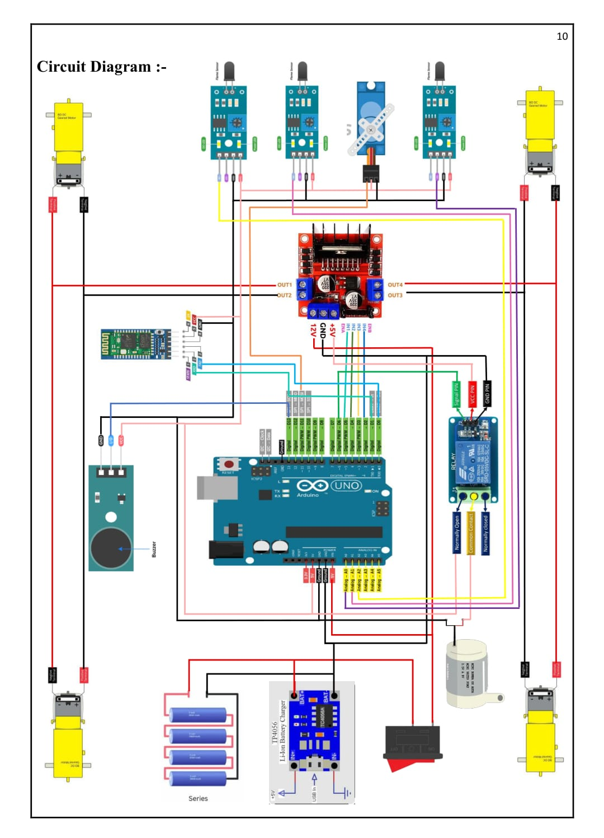
CIRCUIT DIAGRAM

Slide 9
WORKING OF FIRE FIGHTER
Our Robot work in two mode , manual mode and automatic mode.
Manual Mode : User connect smart phone to robot via HC-05 Bluetooth module . Through a mobile app commond like
forward ,backword ,left ,right pump ON/OFF are sent .
L298N Moter Driver receives signals from Arduino and controls the DC moters for movement .
User manually direct the robot towards fire and activates the water pump to extinguish it .
Automatic mode : Three flame sensors continuously monitor for fire in Left Right ,amd front direction .
If fire is detected ,sensors send signal to Arduino uno .Arduino process es the direction and movew the robot towards the fire
Using L298N Moter Driver , servo moter rotates the water nozzle towards the exact fire location .
Relay module switches ON the water pump and water sprayed .
Buzzer starts beeping to alert people nearby once fire is extinguished ,all systems stop automatically .

Slide 10
FLOW CHART
READ SENSOR
VALUE
FIRE DETECTED
INFRONT
YES YES
NO
YES
NO
YES
NO
YES
YES
FIRE DETECTED RIGHT
TURN TO RIGHT
TURN TO LEFT
FIRE DETECTED FRONT
MOVE FORWARD
REACH SPRAYING DISTANCE
ACTIVATE SPRAY

Slide 11
FUTURE SCOPE & LIMITATIONS
Camera integration :- A wireless camera can be added for live video streaming .user can fire location from mobile and control
robot more accurately .
GSM Module :- by adding GSM , the robot can send SMS or call alerts to the fire department when fire is detected .
Gas Sensor :- MQ – 2 or MQ-6 Sensor can be added to detect smoke and LPG Gas leakage before fire starts.
AI & IOT Based :- with AI , The robot can decide the best path to reach fire . Using IoT , multiple robot can work
together and data can be store on cloud.
Larger size :- The same concept can be scaled up for big industrial fire fighter vehicles .
Limitations
Range Issue :- Bluetooth HC -05 has a range of only 10 – 15 meter .so manual control is not possible from long
distance
Wwater tank :- The robot carries a small water tank ,so it can not extinguish large fire .it is only useful for small initial stage fire .
Surface dependent :- This robot work best on flate surfaces . It can not climb stairs or move on rough terrain .

Slide 12
Applications
Residential buildings :- Used in homes and apartments to extinguish small fire caused by kitchen accidents or short
circuits during initial stage
Educational institutions :- Can be deployed in school and collage labs to handle chemical or electrical fire while keeping
student at a safe distance .
Offices & data centers :- protects important documents and server rooms from fire damage .useful where human
entry is risky due to smoke or toxic fumes .
Small scale industries :- Acts as a first response system in factories before the fire brigade arrives save time and
property
Hospitals :- Helps extinguish fire in sensitive areas like ICU or operation theaters where patient evacuation is
difficult . and more application like that forest areas , Military & Defence system ,shoping malls etc.

Slide 13
Result
The project is 100% working and can be used as a first response system for small scale fire emergencies
In homes , labs offices , industries ,it reduce human risk and provides immediate action before the fire spreads.
The robot successfully detected fire from 25-30 cm using flame sensors.
In automatic mode it moved towards the fire and extinguished it within 10-15 seconds.
In manual mode all commands from the mobile app worked properly via Bluetooth up to 10 meter range.
The water pump and buzzer system operated correctly during testing .

Slide 14
Conclusion
The Bluetooth & Automatic controlled firefighter robot was successfully designed tested .it works efficiency
In both Automatic and Manual mode to detect and extinguish small fires .
This project provides low cost ,reliable ,and safe solution that reduces human risk during fire emergencies .
It act as first responder and can prevent major loss controlling fire the initial stage .

Slide 15
THANK YOU

